Slide 1
Developing a Teaching Agenda
The Thirteenth Meeting of New Researchers in Statistics and Probability
Vancouver, British Columbia
July 30, 2010
John Gabrosek
Associate Professor
Department of Statistics
Grand Valley State University

Slide 2
Collaboration Literacy Intentionality Planning

Slide 3
Collaboration
Understand The Teaching Culture
Connect To Colleagues
Use colleagues teaching materials
Create a reading circle
Visit colleagues’ classrooms
Identify a teaching mentor

Slide 4
Literacy
Be Aware Of Educational Research
Journal of Statistics Education (JSE)
Statistics Education Research Journal (SERJ)
Teaching Statistics (TS)
The American Statistician (TAS)
Mathematics Teacher (MT)
Technology Innovations in Statistics Education (TISE)

Slide 5
Literacy
Applets
STAT ATTIC
CAUSE
Data Set Collections
JSE Data Archive
CAUSEweb.org Resources
The Data and Story Library (DASL)

Slide 6
Literacy
Data Set Sources
Center for Disease Control and Prevention (CDC)
Bureau of Transportation Statistics (BTS)
Fish and Wildlife Research Institute
The Baseball Archive
Statistics Canada

Slide 7
Literacy
Assessment
Assessment Resource Tools for Improving Statistical Thinking (ARTIST)
The Survey of Attitudes Toward Statistics (SATS)
Statistics Anxiety Rating Scale (STARS)

Slide 8
Literacy
Attend Teaching Conferences
International Conference on Teaching Statistics (ICOTS)
United States Conference on Teaching Statistics (USCOTS)
Join ASA Section On Statistics Education

Slide 9
Intentionality
Understand Your Students
Reflect On Teaching
Be Creative
Don’t Get Discouraged

Slide 10
Planning
Carve Out Teaching Time
Say NO
Work on Teaching Materials
Teach Outside The Classroom

Slide 11
A Few Teaching Tips
Teach To Your Personality
Be Organized
Think About What The Student Does
Learn Names
Set Reasonable Course Rules And Stick To Them
Make Connections In Course Content

Slide 12
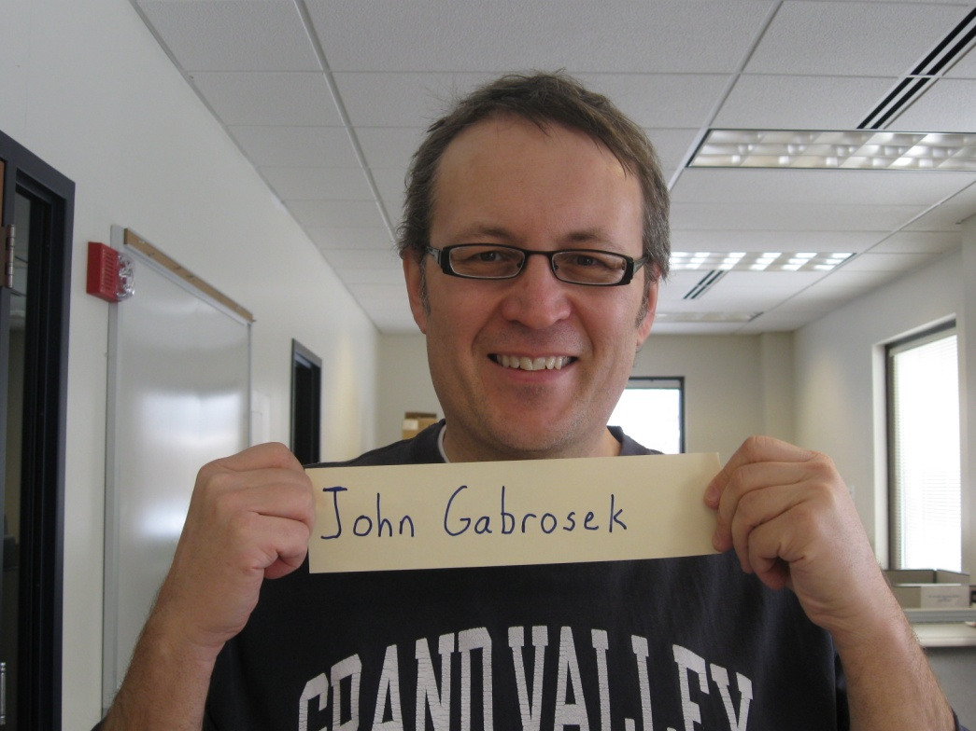
A Few Teaching Tips

Slide 13
Contact Information
John Gabrosek
Associate Professor
Department of Statistics
Grand Valley State University
Webpage: http://faculty.gvsu.edu/gabrosej
Email: gabrosej@gvsu.edu

